Slide 1
SoC Design Verification, Test and Trends.
Medini J Aradhya
ECE Graduate Student.

Slide 2
Introduction
A system on chip (SoC) is an integrated circuit that integrates all components of an electronic system.
Most electronic devices today are architected through a System-on-Chip design paradigm where the idea is to develop a system through integration of pre-designed hardware and software blocks, often collectively referred to as design Intellectual Properties.
SoC Veriﬁcation involves two independent ﬂows, one for ensuring correct operation of the IPs and another for the assembled system.

Slide 3
Verification Planning
Veriﬁcation planning is the creation of appropriate test plans, test cards, deﬁnition of specialized design blocks called Veriﬁcation IP, instrumentation in the design for post-silicon debug and deﬁnition of various monitors
Architecture Verification
Functional veriﬁcation of communication protocols.
Initiate development of hardware prototyping models

Slide 4
Pre-Silicon Verification
An IP veriﬁcation team perform the veriﬁcation of the IP being delivered. This is done in a standalone environment, then subsequently the team would integrate the IPs into an SoC model and perform system-level veriﬁcation.
IPs are delivered to the SoC integration team either as hard IP or as soft IP.
SoC integration veriﬁcation includes system-level simulation and in many cases require co-execution of hardware and software modules.

Slide 5
FPGA Prototyping
The RTL model of the hardware is mapped into a reconﬁgurable architecture such as FPGA, or specialized accelerators and emulators.
These models run about hundreds to thousands times faster than an RTL simulator; consequently, one can execute hardware/software use case scenarios such as an operating system boot in a few hours.
Due to the different use case requirement for different devices, creating reusable veriﬁcation ﬂows is difficult.
Post-Silicon Verification
Post-silicon validation is the activity where one uses an actual silicon artifact instead of an RTL model.

Slide 6
VERIFICATION CHALLENGES
Shrinking Veriﬁcation Time
Limited Tool Scalability
Speciﬁcation Capture
Use Case Identiﬁcation
Power Management Challenges
Security and Functional Safety
Hardware/Software Co-veriﬁcation
Analog and Mixed Signal Components

Slide 7
Shrinking Veriﬁcation Time
exponential growth in devices resulted in shrinkage of time in both design and verification
Due to the different use case requirement for different devices, creating reusable veriﬁcation ﬂows is difficult
Limited Tool Scalability
The increasing requirements for conﬁgurability and consequent increase in design complexity
To address this problem, there has been a growing trend in formal methods to target speciﬁc applications which increases cost.

Slide 8
Speciﬁcation Capture
Lack of specifications
SoC design requirements span across multiple documents which makes it harder to characterize the intended behavior of an SoC .
Use Case Identiﬁcation
Due to the design complexity ,verification has moved towards more narrowly deﬁned coverage of intended usage scenarios
The exploration and planning phases of the device deﬁnes a set of use cases which constitute the target usages of the device.

Slide 9
Power Management Challenges
Power gating and clock gating have helped in power reduction but resulted in verification complexity.
power-gated IPs may make it difﬁcult to observe behavior of other IPs that are not in sleep states
Security and Functional Safety
Security and Functional requirements are often poorly speciﬁed and understood.
Safety mechanisms which are implemented for functionality under the circumstances of unexpected errors.

Slide 10
Hardware/Software Co-veriﬁcation
With the increase in complexity of the design, it is difﬁcult to make the distinction between software and hardware.
validating software requires an underlying hardware model that is stable, mature, and fast which is almost at the end of the design.
Analog and Mixed Signal Components
Due to the complex nature of analog behavior, design and veriﬁcation methodologies of analog circuits are far more primitive
Veriﬁcation of analog and mixed-signal ICs remains complex, expensive and often a ”one-off” task

Slide 11
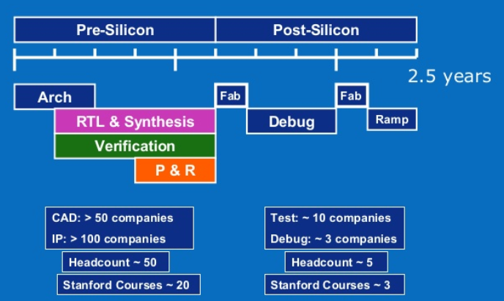
Verification Trends
Verification Trends over the years – Industry study :
Verification-Highest Time & Cost consuming Process.
Increase in Emulation and use of FPGA Models – Fast Prototyping
Several Pre - Silicon Validation Runs
Increased use of simulation-based & targeted formal verification.
Challenge - Scalability Requirement.
Industry is shifting focus from full functional verification to domain specific verification targeted towards critical design features.
Use of data analytics to increase efficiency of verification process.
Notes:
The question that arises next would be how these requirements are then getting incorporated in todays products ?

Slide 12
A. Simulation Technologies
Simulation-based verification methodology - automated process with Verification plan that defines all parameters to be verified. Then Stimuli (tests) are manually crafted or generated by test generator. Followed by checking, coverage collection.
Metric (coverage) driven Verification – Industry Paradigm
Speedup in Simulation is heavily dependent on performance of the underlying machine brought about by technology scaling.
Leverage parallel computation to accelerate simulation. However event driven nature of simulators & RTL code interdependencies make the serialized nature hard to parallelize
Break RTL code into several independent blocs capable of running independent threads with min synchronization.
Notes:
1) Simulation and test generation are the two core technologies in simulation-based verification
2) It is challenging to increase performance only with Technology scaling

Slide 13
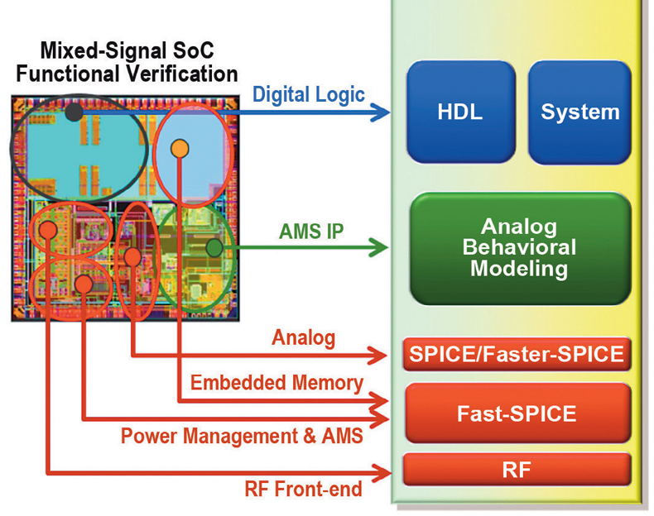
Discussing a few Application specific design feature implementation in Verification :
Analog and Mixed Signal (AMS) Verification : A) Test bench architecture : Analog on top & Digital on top modules B) Analog Modules of different abstraction levels are used through the Project lifecycle. Tradeoff b/w simulation Speed and Accuracy. C) Difficult to implement checkers for AMS as we have to consider both time and frequency domains.
Technologies

Slide 14
Power-Aware Verification: A)Power Gating -> Power Intent file creating necessary circuits during synthesis. B) Power Intent file -> design flaws in low power SoC designs. C) Power-Aware simulators are now focusing on Multiple voltage designs and DVS D) Capture bugs & estimate power consumption..
Functional Safety Verification: A) Fault verification essential to verify robustness. B) Faults injected into design components to simulate HW errors. Safety module – functional unit & checker unit. C) Single Point of Failure is not tolerable for safety critical SoCs. D) Post-layout - more accurate fault modeling & fault distribution. But increases complexity. E) Current Fault injections/ verification done randomly @ unit level.
Notes:
When a fault is injected, the simulator outputs whether the fault can propagate to the functional output and the checker output. If a single fault can propagate to the functional output and cannot be detected by the checker, it
means that the fault can propagate to the system without recovery, which is a Single Point of Failure.
Challenging to account for all kinds of faults, Analog faults are hard to simulate. And more research work is being done in this area. Along with HW SW co verification.

Slide 15
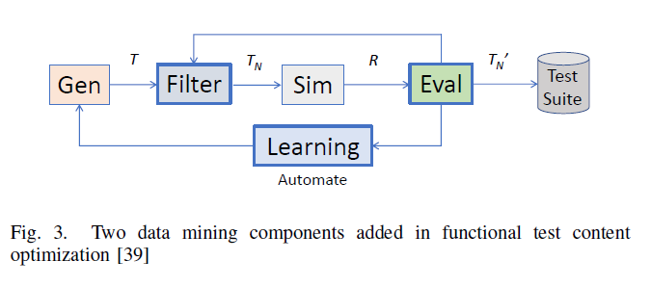
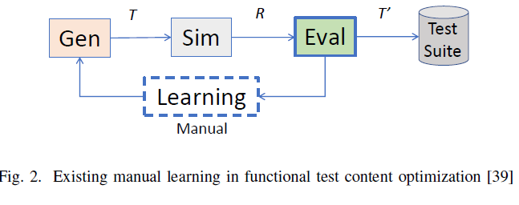
B. Test Generation & Data Analytics
Increasing Reusability of Test Generation Infrastructure.
Increasing Efficiency - high quality tests. – Functional Test Content Optimization.
Capture test scenarios and then to map to tests having details at different levels of abstraction
Use of Datamining techniques and Machine learning algorithms.

Slide 16
Conclusion
Challenges faced by verification technologies
Lack of speciﬁcation
Tool scalability
Challenges in security validation
Steps to alleviate bottleneck in effort and cost :
Addressing tool scalability
Targeting veriﬁcation to speciﬁc needs
Scalability and robustness in veriﬁcation

Slide 17
QUESTIONS?

Slide 18
THANK YOU

